Slide 1
Agile software requirements
Palle 2018

Slide 2
Agenda and learning objectives
Agenda
Agile requirements specification
User acceptance test – Accept test driven development (ATDD)
Learning objectives
Understand the relation between quality, requirements and acceptance test
Be able to write user stories
Be able to write user acceptance tests
Goal
Have formulated user stories for the system chosen for semester project
Have formulated User acceptance tests for the system chosen for semester project

Slide 3
Key Concepts in Systems Development
Initiating a systems development
Participants involved in a SD project
Reasons for having a new system
Information systems planning
High level system requirement
Feasibility analysis (Financially and technologically)
Selection of system development model
Objectives and schedule for SD
Build the system (System Development)
Detail analysis – Precise system requirements (user accepted), a list of user acceptance tests
System design – modules, interfacing amongst modules, hardware requirements, programming language, OS
Coding
In-house testing – unit test, system test, stress test
User acceptance test

Slide 4
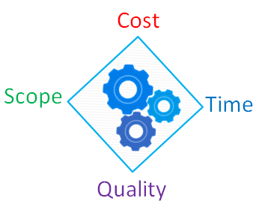
Quality
– what we do not compromise
Software quality is a complex mix of factors, which vary depending on the applications and the customers who demand them
Functional software quality reflect the extent to which the software corresponds to or satisfy a given design based on functional requirements or specifications
Structural software quality indicates the extent to which software meets the non-functional requirements that support the delivery of the functional requirements such as robustness, maintainability, the degree of how correct software is made
There are a number of implicit requirements rarely mentioned (eg. usability)
If the software meets the explicit requirements, but not the implicit, the software quality debatable

Slide 5
Functional and non-functional requirements
Functional requirements
"A requirement specifies a function that a system or component must be able to perform.“
Can be specified in different ways:
XP: User stories test cases
UP: Use cases
…: Features list
Non-functional requirements
"A non-functional requirement is a statement of how a system must behave, it is a constraint upon the systems behaviour."
Non-functional requirements specify the requirements not covered by the functional requirements
They specify criteria accessing the use of the system rather than a specific behaviour
Ex.: "Display of the students' satisfaction level must appear within 2 milliseconds."

Slide 6
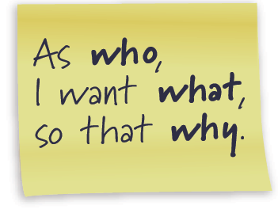
User stories
Formulated by team (including PO)
Estimated by the team
Used as basis for sprint planning/planning game
For each user story in the sprint back the team must create test scenarios in cooperation with PO
Scope (PO)
Estimate (team)
Importance (PO)

Slide 7
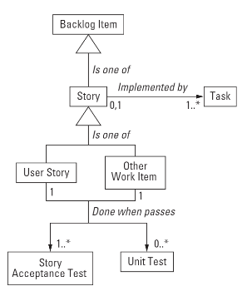
User story form
Card
A short sentence to describe the intent of the user story
Conversation
A discussion between the team and PO to determine the more detailed behavior
The card is a promise of conversation
Confirmation
Represents the acceptance test in which the PO will confirm whether the story is implemented to their satisfaction

Slide 8
Invest in good User Stories
Independent
A story can be developed, tested and potentially delivered on it’s own
Negotiable
A story is a placeholder for discussion, development, test and acceptance
Valuable
Stories are prioritized by value and succeeds or fails based on the value it provides
Stories are functional (vertical) slices
Estimable
If a story cannot be estimated due to largeness – it should be split
If a story cannot be estimated due to uncertainty – a functional spikes can help reduce uncertainty
Small
Stories must be small enough to be completed in an iteration
Testable
All code is tested code
Acceptance Test Driven Development (ATDD)

Slide 9
Three-point estimation - an alternative to poker planning
b = best case scenario
m = most probably scenario
w = worst case scenario
Estimate
E = (b + 4*m + w)/6
The estimate is a weighted average taking in to consideration both worst case and best case estimates
Standard deviation
SD = (b + W)/6
The standard deviation depicts the variation or uncertainty of the estimate

Slide 10
Videos
Explaining Agile - Martin Fowler and Neil Ford at USI
https://www.youtube.com/watch?v=GE6lbPLEAzc
Agile Product Ownership in a nutshell
http://www.youtube.com/watch?v=502ILHjX9EE
Product Backlog Grooming Meeting
http://scrumtrainingseries.com/

Slide 11
"If it isn't tested, it doesn't exist."
Accept test

Slide 12
Main categories of testing
A business-facing test is one you could describe to a business expert in terms that would (or should) interest her . . . . You use words drawn from the business domain:
“If you withdraw more money than you have in your account, does the system automatically extend you a loan?”
A technology-facing test is one you describe with words drawn from the domain of the programmers:
“Different browsers implement JavaScript differently, so we test whether our product works with the most important ones.”

Slide 13
Accepttest definition
Acceptance tests described black-box requirements
Identified by your project stakeholders
Which your system must conform to
Acceptance tests are first class requirements artifacts because they describe the criteria by which stakeholders will determine whether the system meets their needs
They're executable specifications
Acceptance test is also called:
Customer (Acceptance) Tests
Functionality test
“Conditions of satisfaction"

Slide 14
ATDD -
Acceptance Test Driven Development
A development methodology based on communication between the business customers, the developers, and the testers
ATDD encompasses acceptance testing, but highlights writing acceptance tests before developers begin coding
ATDD is closely related to Test-Driven Development
It differs by the emphasis on developer-tester-business customer collaboration

Slide 15
Acceptance Test Driven Development - ATDD

Slide 16
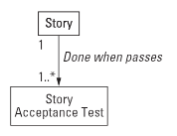
Acceptance Tests
Acceptance tests are created from user stories
During an iteration the user stories selected during the iteration planning meeting will be translated into acceptance tests
The acceptance test specifies scenarios to test when a user story has been correctly implemented typically during sprint review
A story can have one or many acceptance tests, whatever it takes to ensure the functionality works
Acceptance test are manually business facing tests
Acceptance tests are black box system tests

Slide 17
ATDD - Acceptance criteria
Is a set of conditions that the story must meet for it to be accepted as complete
It’s not a replacement for conversation with the product owner
It’s the result of the conversation
Format:
Given [precondition] (setup)
A specified state of a system
When [Actor + Action](trigger)
An action or event occurs
Then [Observable result](verification)
The state of the system has changed or an output has been produced

Slide 18
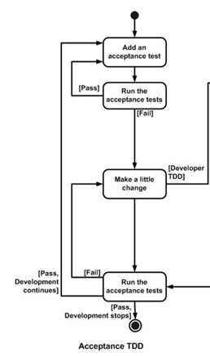
Acceptance test
Acceptation criteria are NOT tests
Acceptance criteria
+ Examples (data + scenarios)
= Acceptance tests

Slide 19




ATDD
- Acceptance criteria example
Check out book: “As a user, I want to check-out a book from the library so that I can bring it home to read”
Given: Book is not checked-out & User who is registered on the system
When: User checks out a book
Then: Book is marked as checked out
What if the book is already checked out?
What if the book does not exist?
What if the user is not registered in the system?
Is there a date that the book is due to be checked-in?
How many books can a user check out?

Slide 20
Structured systematic acceptance test
User story | Test case | Precondition | Action | Arguments | Expected behavior | Actual behavior
Check-out book | Check-out book regular - “Happy path” | Borrower is registered Book is not checked-out | n.a. | Borrower name Book title | The book is marked as checked-out by the borrower

Slide 21
Conduction of accept test
Let the customer/end user carry out the test
Do not demonstrate the product your self
Have following roles:
A facilitator
Gives instructions to the user
Without influencing the test
Encourages the users to express their thoughts during the test
The only member of the development team who speaks during the test
A secretary (at least one) who takes notes during the test
Silent observers for the rest of the team

Slide 22

Acceptance test no-go!
Developers writing acceptance tests by themselves, for themselves
Don’t write Acceptance test at unit testing level
Unit tests are implementation specific
Acceptance tests are independent of implementation
Writing tests after the code is finished

Slide 23
For the project
Formulate at least 4 user stories for your project, they have to contain:
Name
Description
Acceptance criteria (with data)
Estimate the user stories

